Slide 1

Tabular Playground Series Apr 2022
By Johnathan Andres

Slide 2
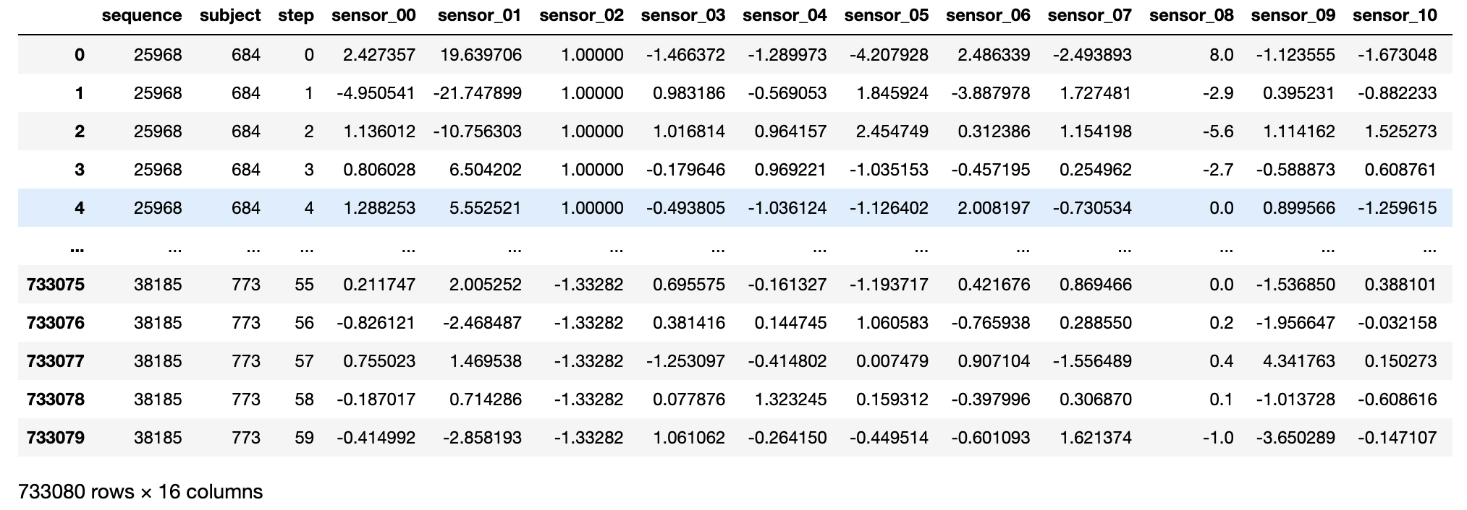
Problem
You've been provided with thousands of sixty-second sequences of biological sensor data recorded from several hundred participants who could have been in either of two possible activity states. Can you determine what state a participant was in from the sensor data?
Input/Feature: 12 sensor Features
Output: 1 of two different states from state 0 or state 1.
Metrics: Area under ROC Curve
Data Details:
Training Set: ~26,000 60-second recordings of thirteen biological sensors for almost one thousand experimental participants
Test Set:~12,000 sequences, you should predict a value for that sequence's state. Over 700k data points.

Slide 3
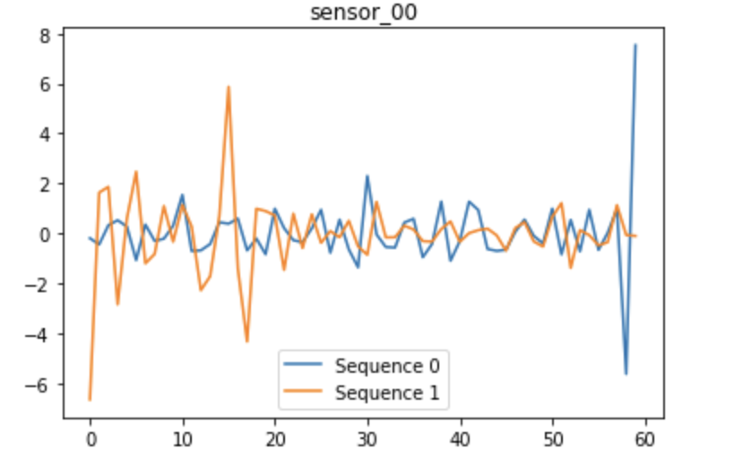
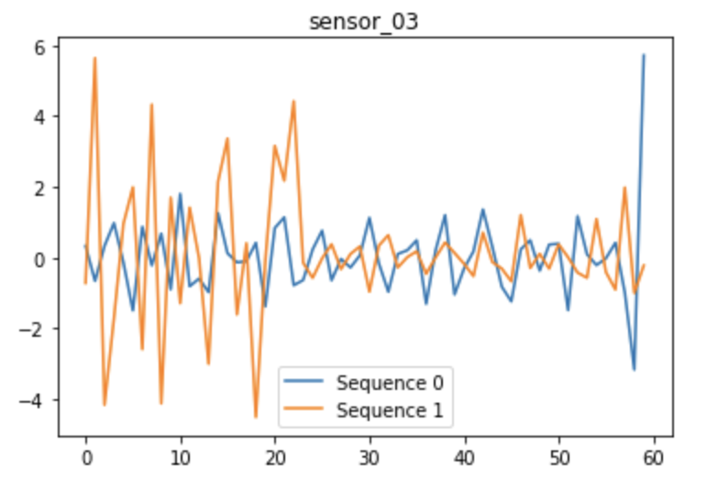
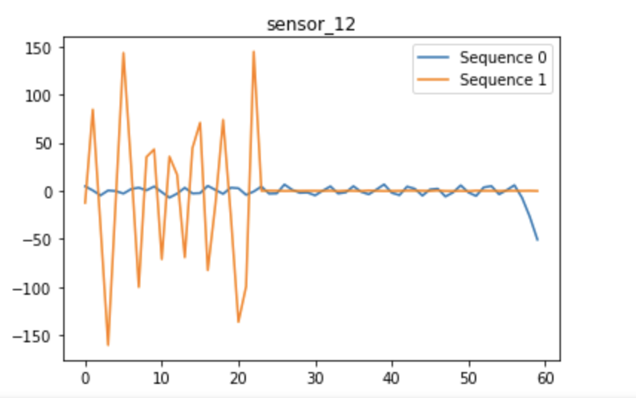
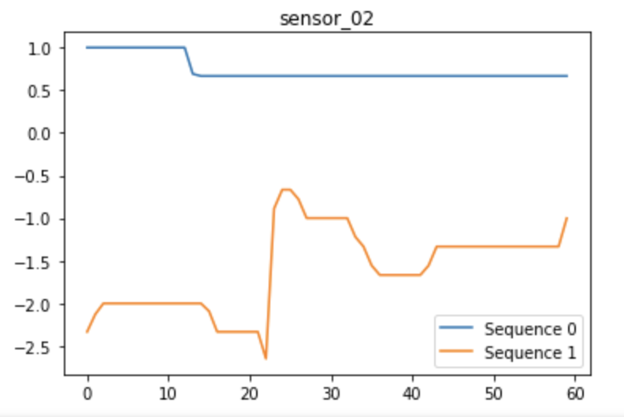
Data Visualization
Here is where I want to get a feel for the data.
These are 4 features of 2 sequences that represent different states.
Gives a little intuition on what might be a more impactful feature as compared to others.

Slide 4
Pre-Processing
Training on 100 sequences. (Computing power)
Over 720 variable given a sequence.
Pre-Processing
Fit data into LSTM formatting
3-D tensor of shape (samples, time step, features)

Slide 5
Formulation
Model
LSTM(Long-short term memory) layer
Useful for longer time step data sets.
Dense relu layer
Dense sigmoid layer(Classification)
Loss: Binary Cross-entropy
Optimizer: Adam (Stochastic Gradient Descent)

Slide 6
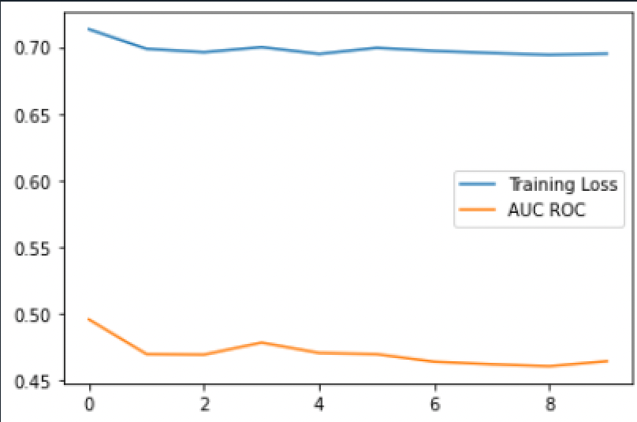
Results/Future
Main Result
Tracked Loss and AUC over epochs
Approximately AUC=.46
Train on a much lower epoch level because of set size.
Future
Check model performance on Test Data Set.
Use a much larger training Data Set for the model.
Compare possibly to a model using a CNN.
Try other optimizers and metrics such as accuracy.

